Slide 1

Notes:
<script type="module"> import mermaid from 'https://cdn.jsdelivr.net/npm/mermaid@11/dist/mermaid.esm.min.mjs'; </script>

Slide 2


Slide 3
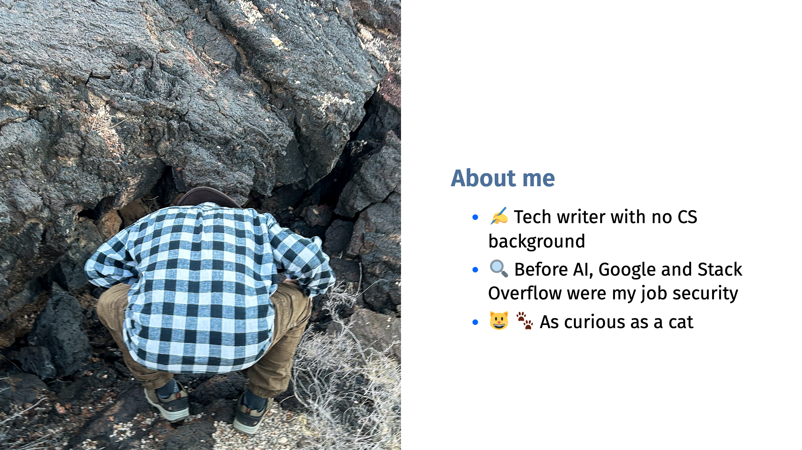

Slide 4
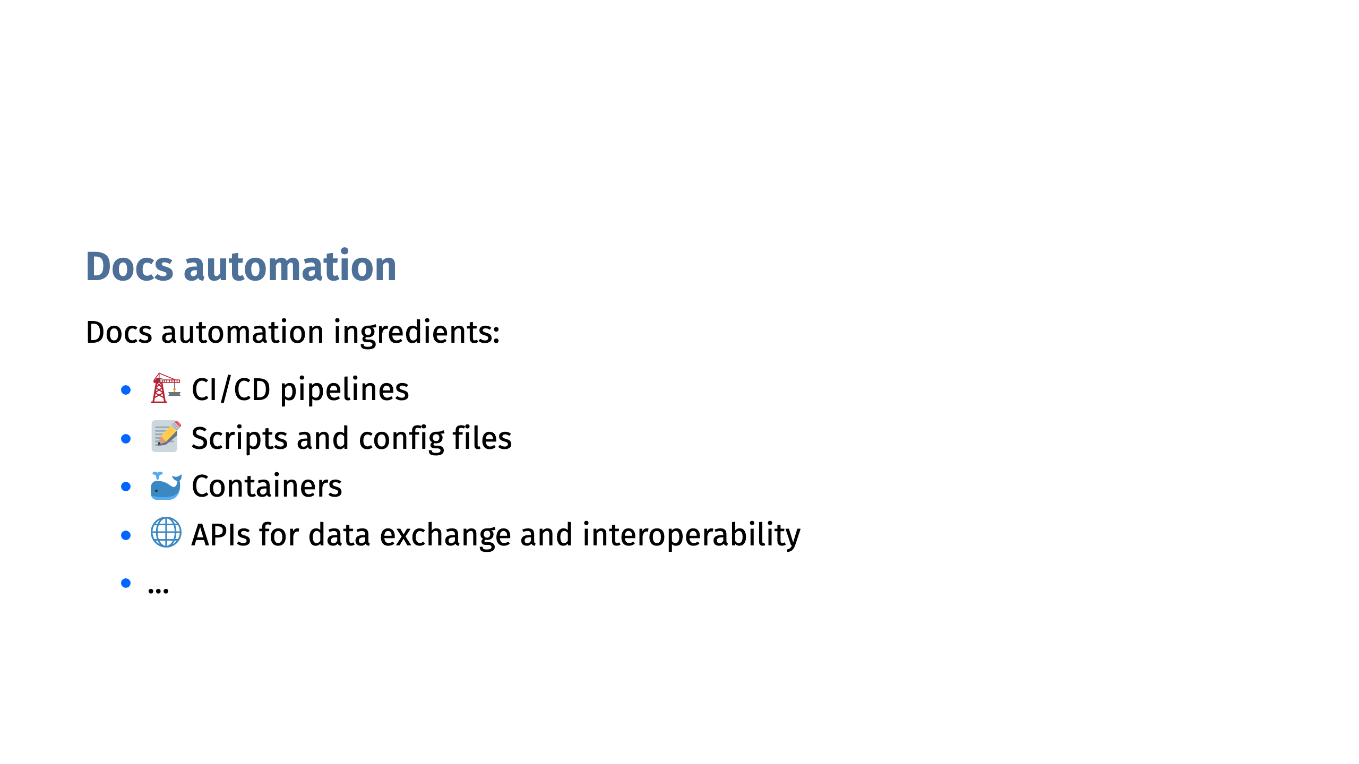

Slide 5


Slide 6
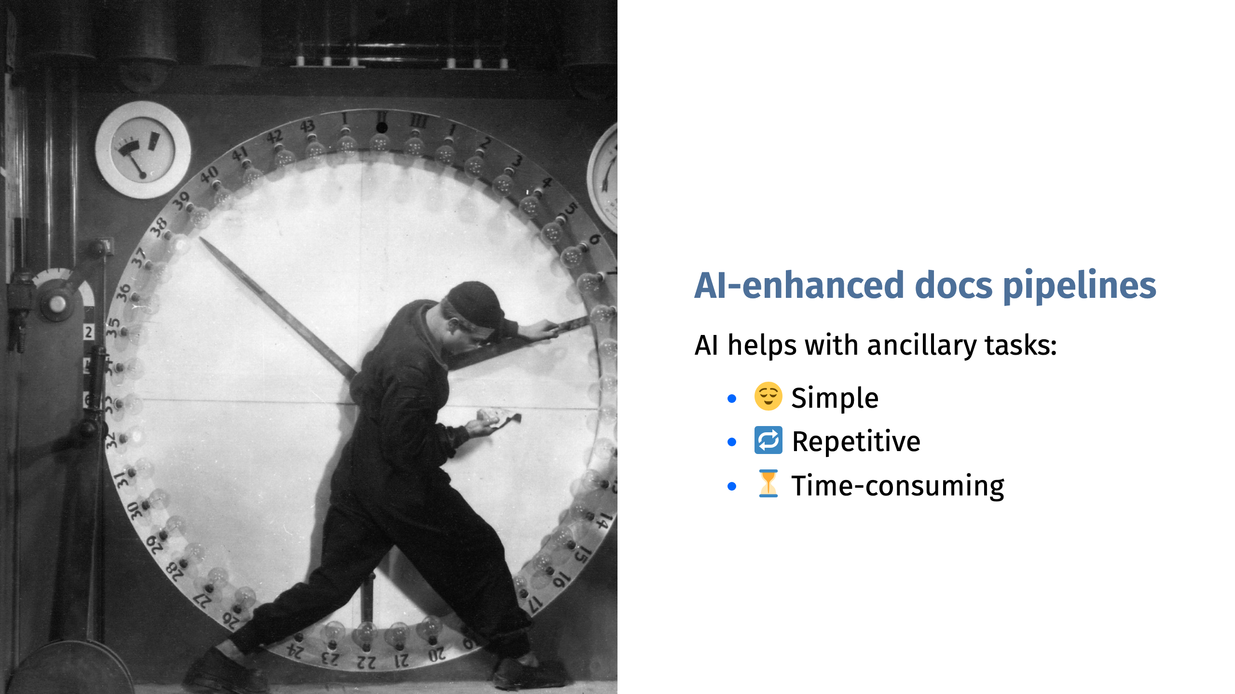
Notes:
AI is good at probabilistic quality: good enough. It's Bad at deterministic quality: exact, repeatable, always 100% consistent

Slide 7
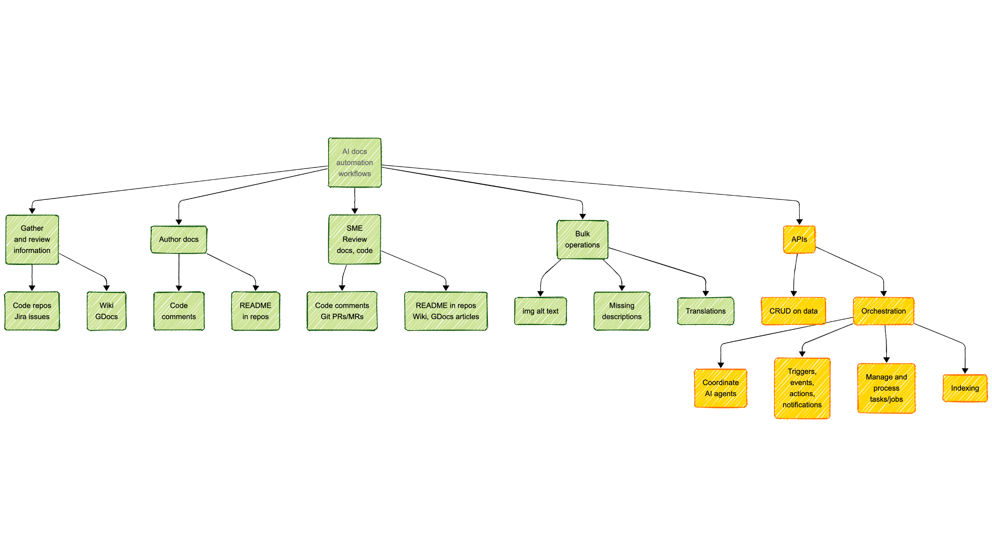

Slide 8


Slide 9
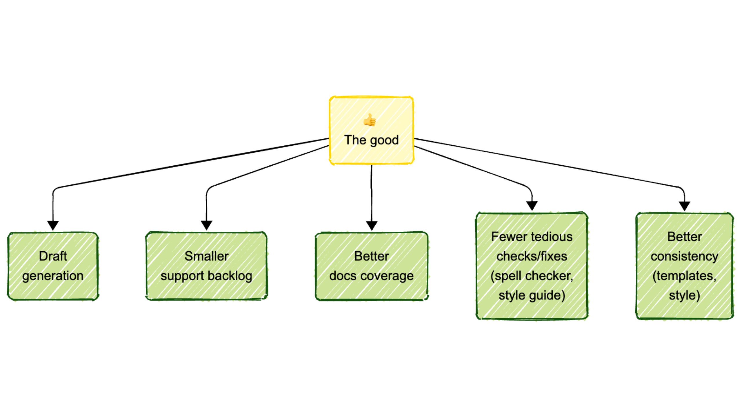

Slide 10
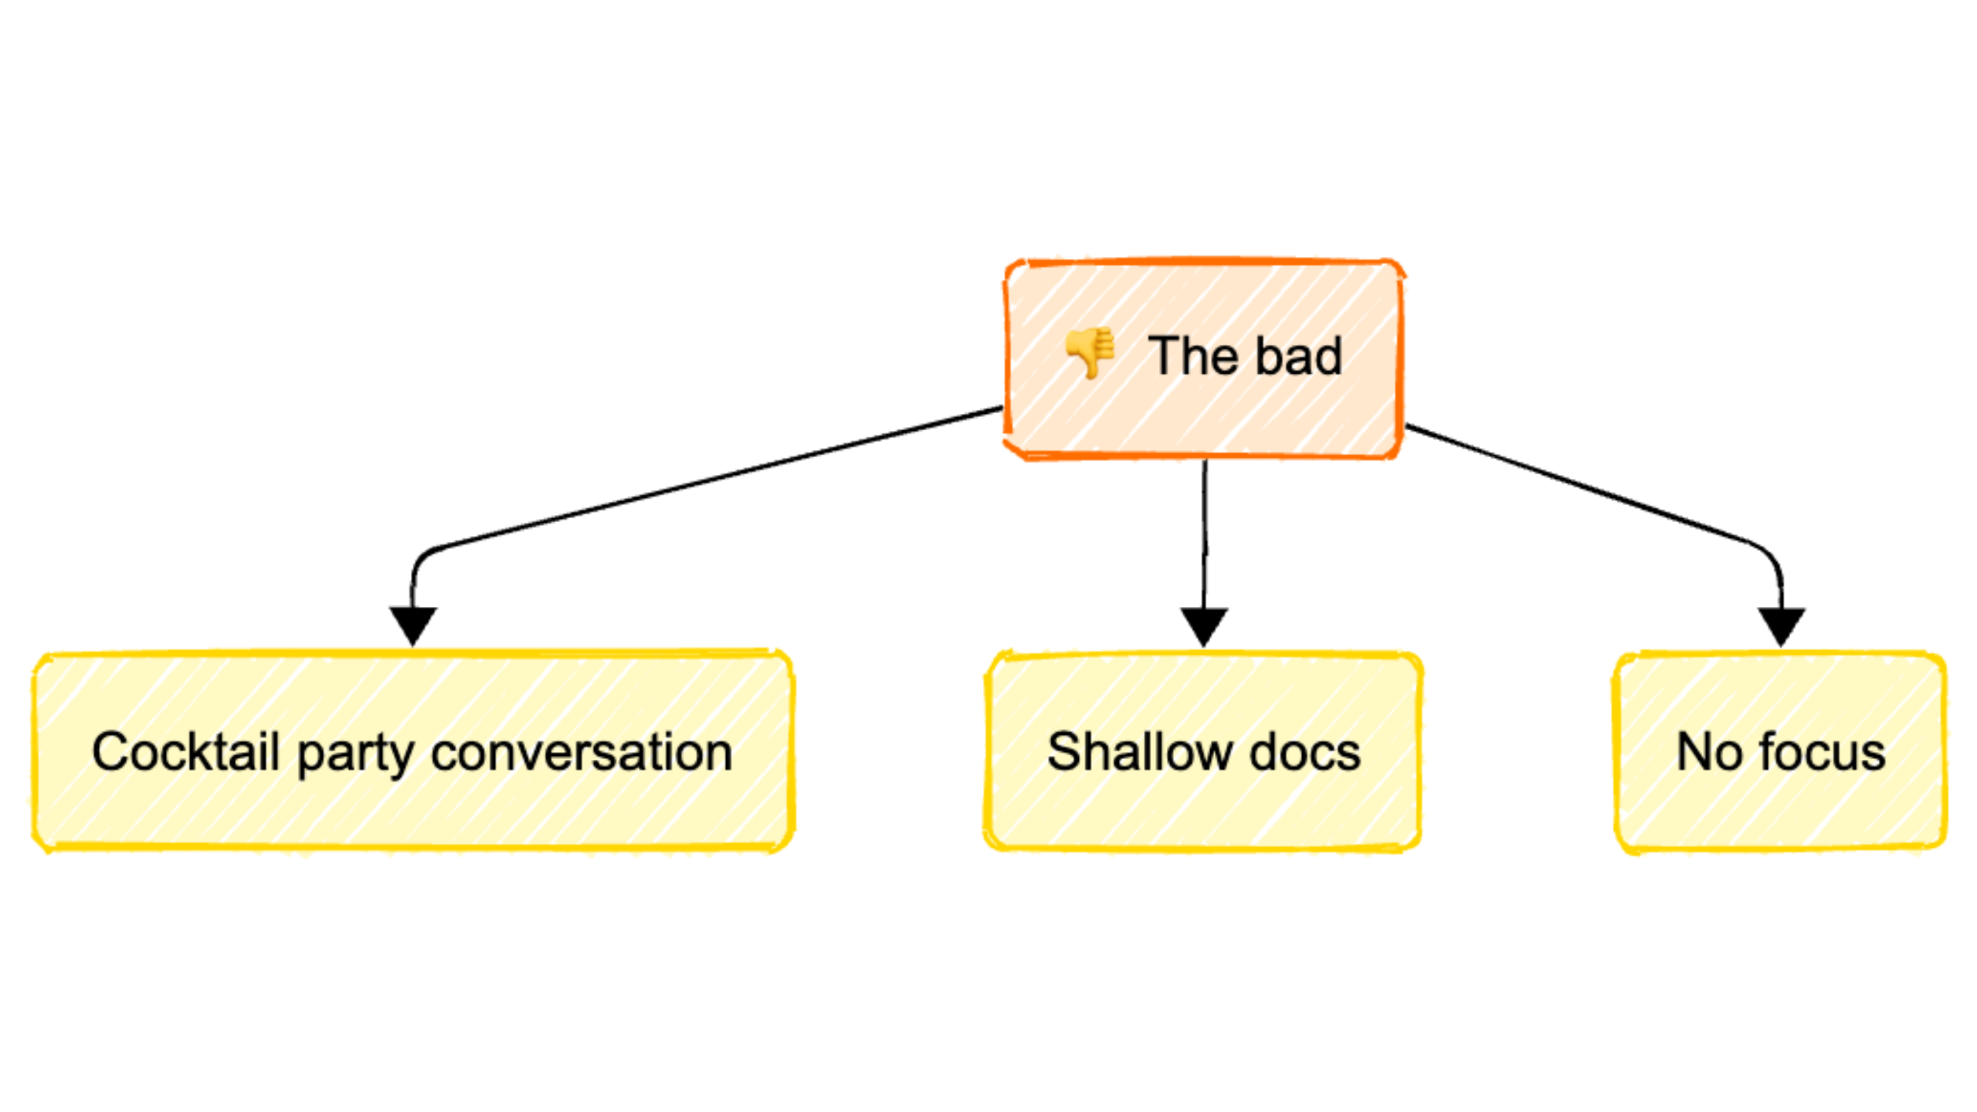

Slide 11
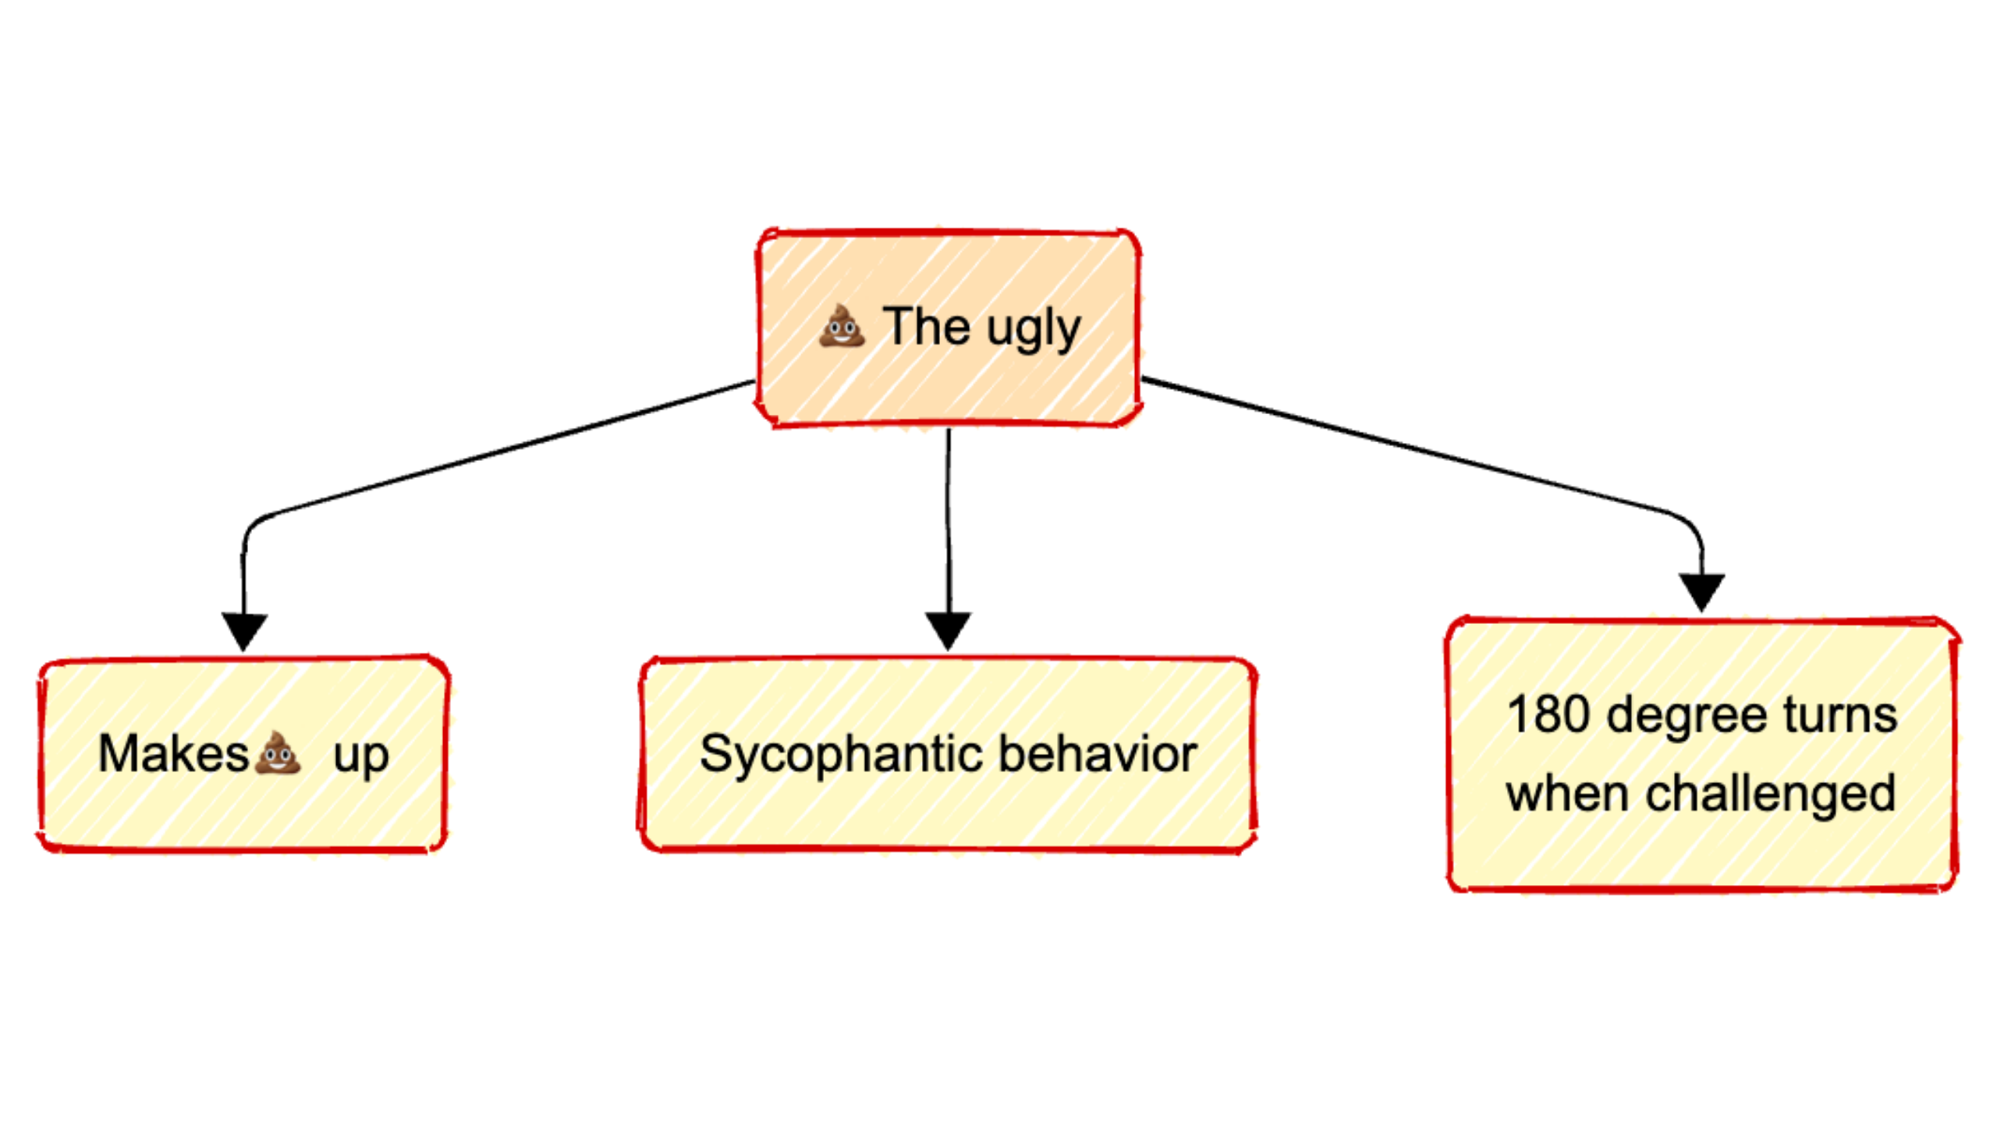

Slide 12
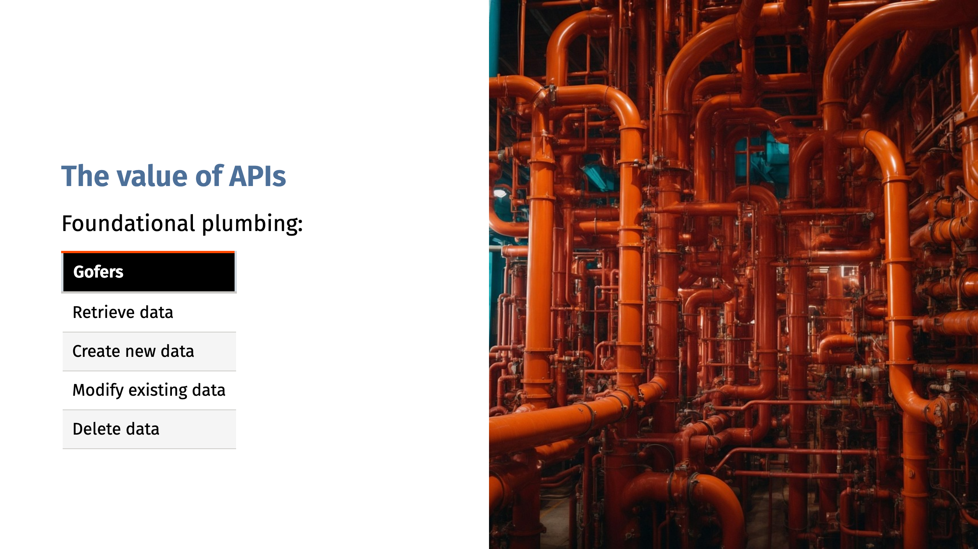

Slide 13
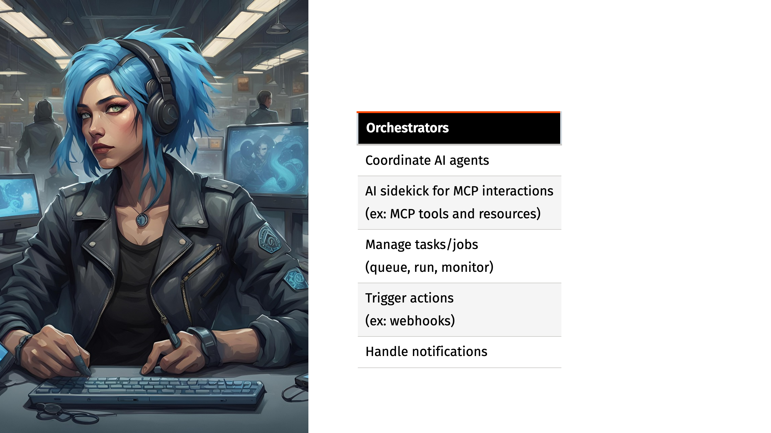
Notes:
Mention Cloudflare blog: https://blog.cloudflare.com/code-mode/ See also: https://github.com/jx-codes/codemode-mcp ## Code Mode: the better way to use MCP Main points and key takeaways ### Main Points - Many AI agents use MCP (Model Context Protocol) by exposing "tools" directly to LLMs (Large Language Models), but this is not optimal. - Cloudflare's new approach is to convert MCP tools into a TypeScript API and have LLMs write code that calls these APIs in a sandboxed environment. - LLMs are significantly better at writing code to interact with APIs than making direct tool calls due to extensive code in their training sets, making this method more scalable and flexible. - MCP acts as a uniform protocol to expose APIs with documentation and authorization, making it easier for AI agents to discover and use new APIs securely. - Cloudflare's "Code Mode" leverages their Workers platform, using lightweight, secure V8 isolates instead of containers to execute code snippets for each agent action. - The new Worker Loader API allows dynamic loading and execution of code isolates, providing a secure and efficient sandbox for AI agent operations, with minimal overhead and enhanced resource isolation. - The bindings approach allows the agent to call specific MCP services securely without general network access, solving issues related to API key leakage and ambiguous network filtering. ### Key Takeaways - LLMs perform better when AI tools are presented as code APIs instead of contrived "tool calls" because real-world coding is more familiar to these models. - MCP remains valuable for its uniformity, enabling discoverable, secure API exposure, documentation, and authorization for AI agents. - Cloudflare's Code Mode introduces a practical paradigm: connect agents to APIs as TypeScript interfaces, execute LLM-generated code in secure sandboxes, and dispatch API calls only via authorized bindings. - The shift to code-centric tool invocation not only improves agent capability and scalability but also addresses security, isolation, and efficiency challenges in AI agent design. - Developers can experiment with this new model using Cloudflare’s Workers platform and the Agents SDK, with local and beta access options available.

Slide 14
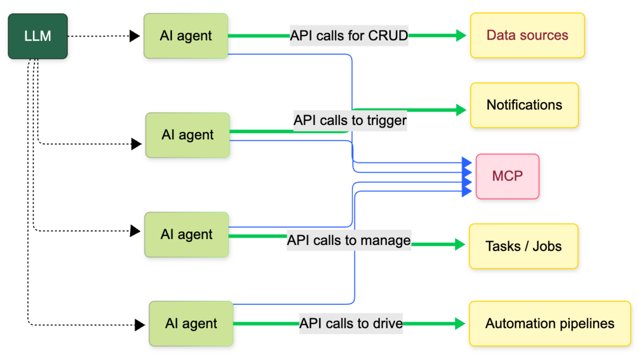

Slide 15
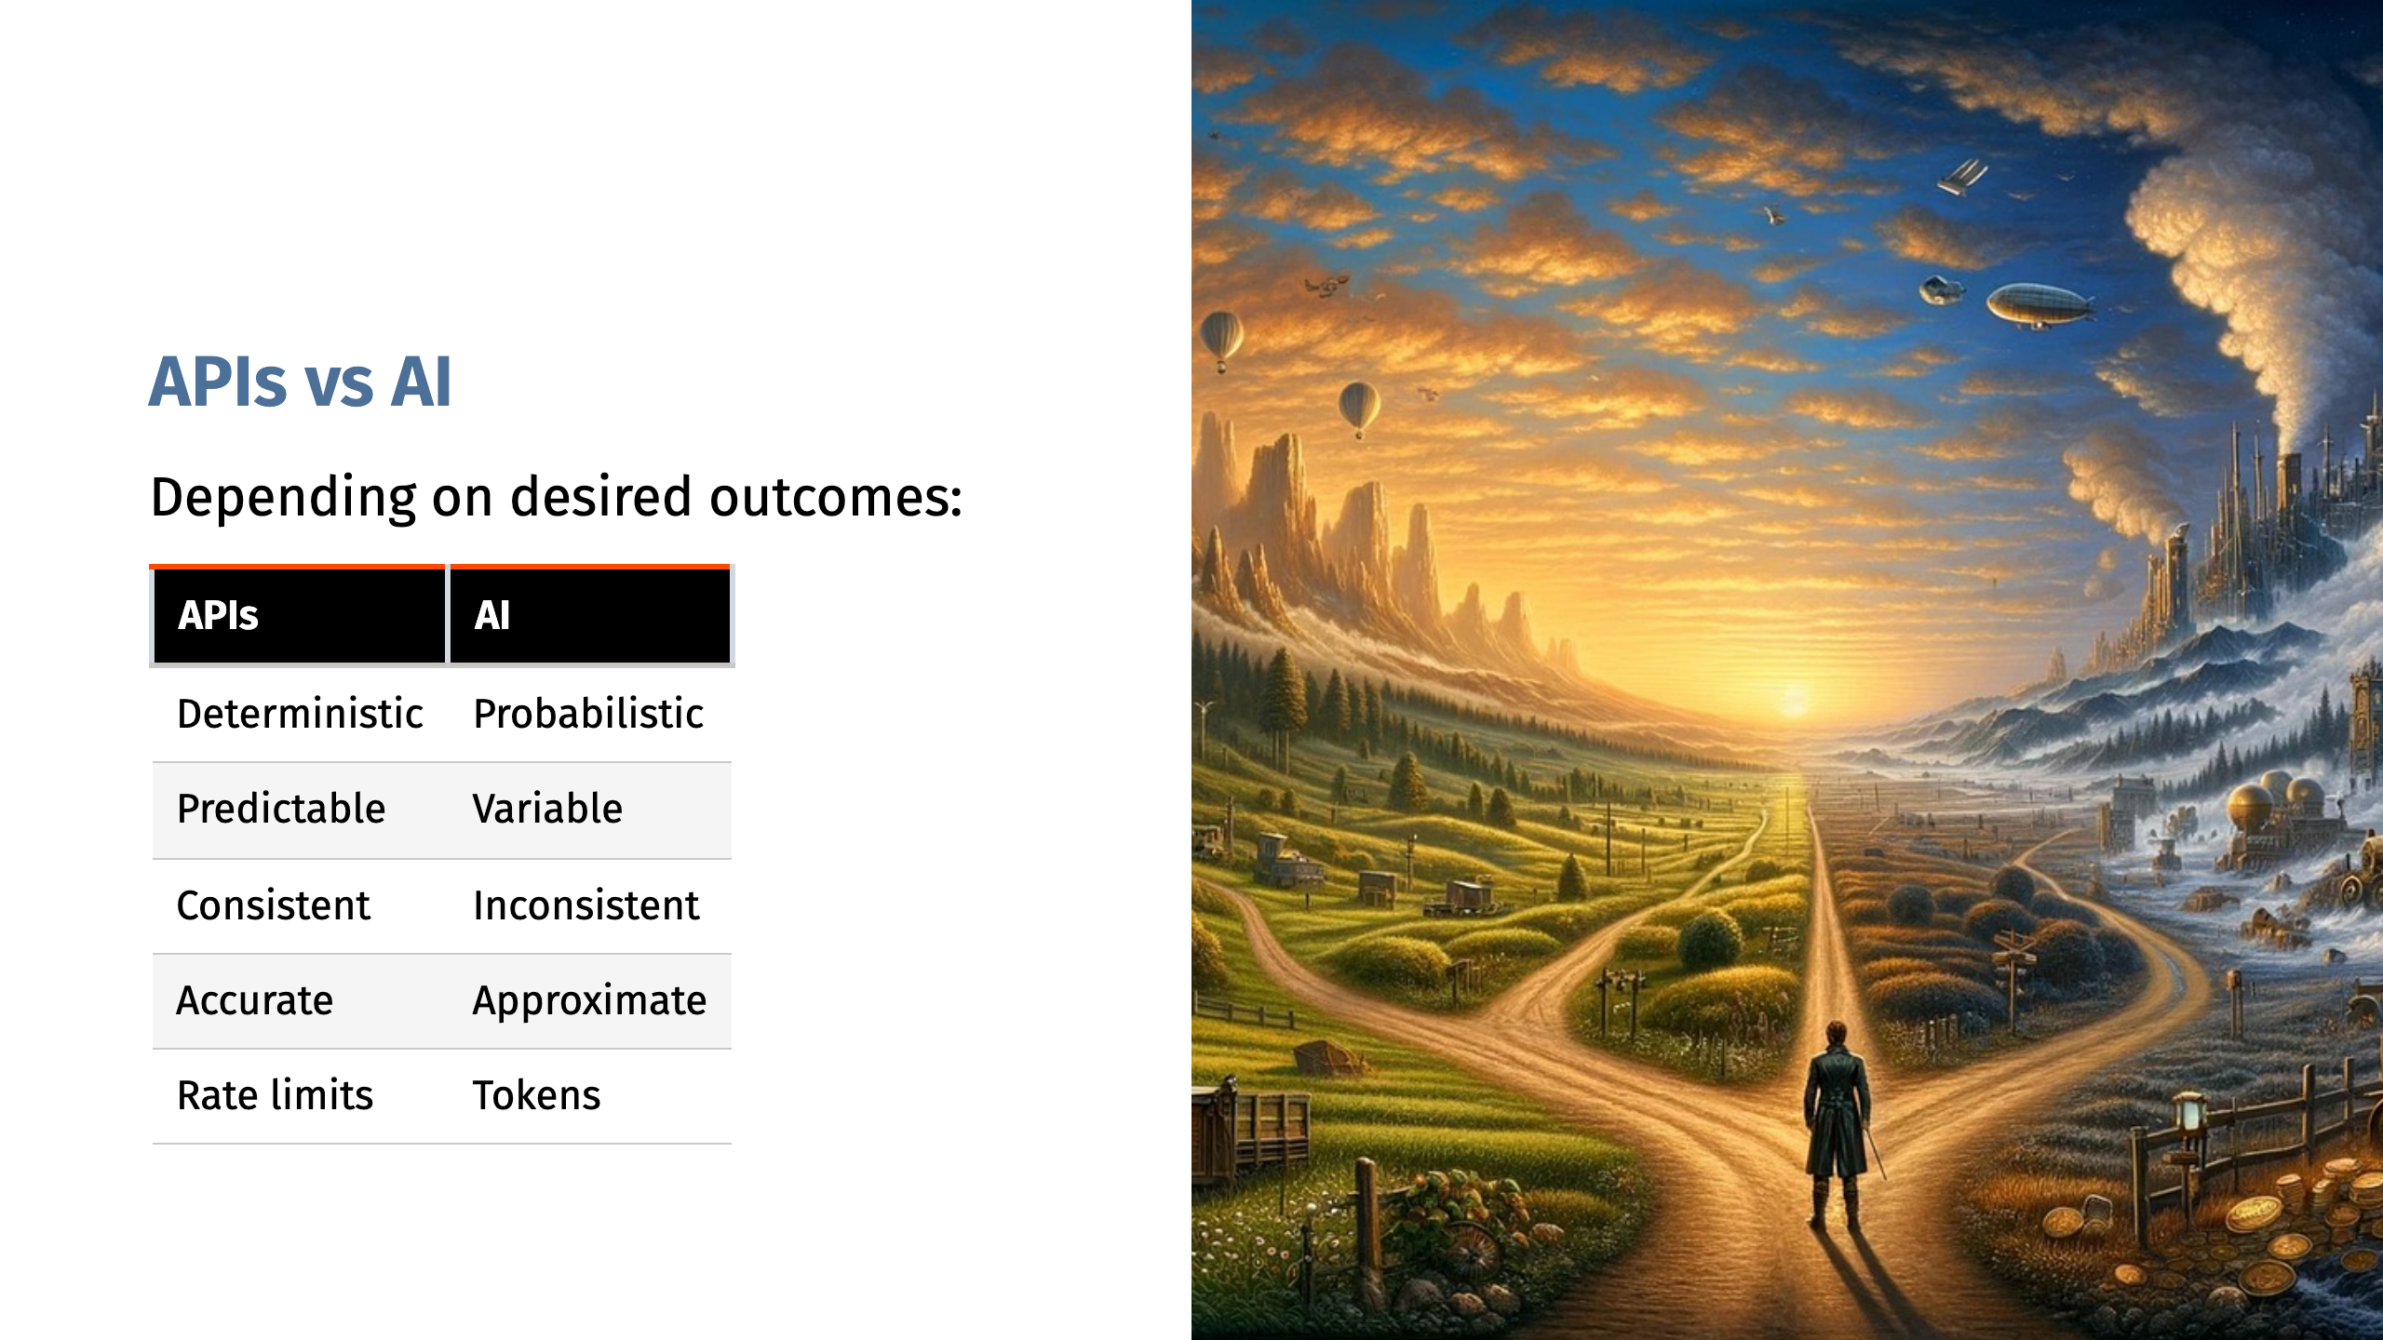
Notes:
For example: Would you delegate authentication and authorization to AI?

Slide 16
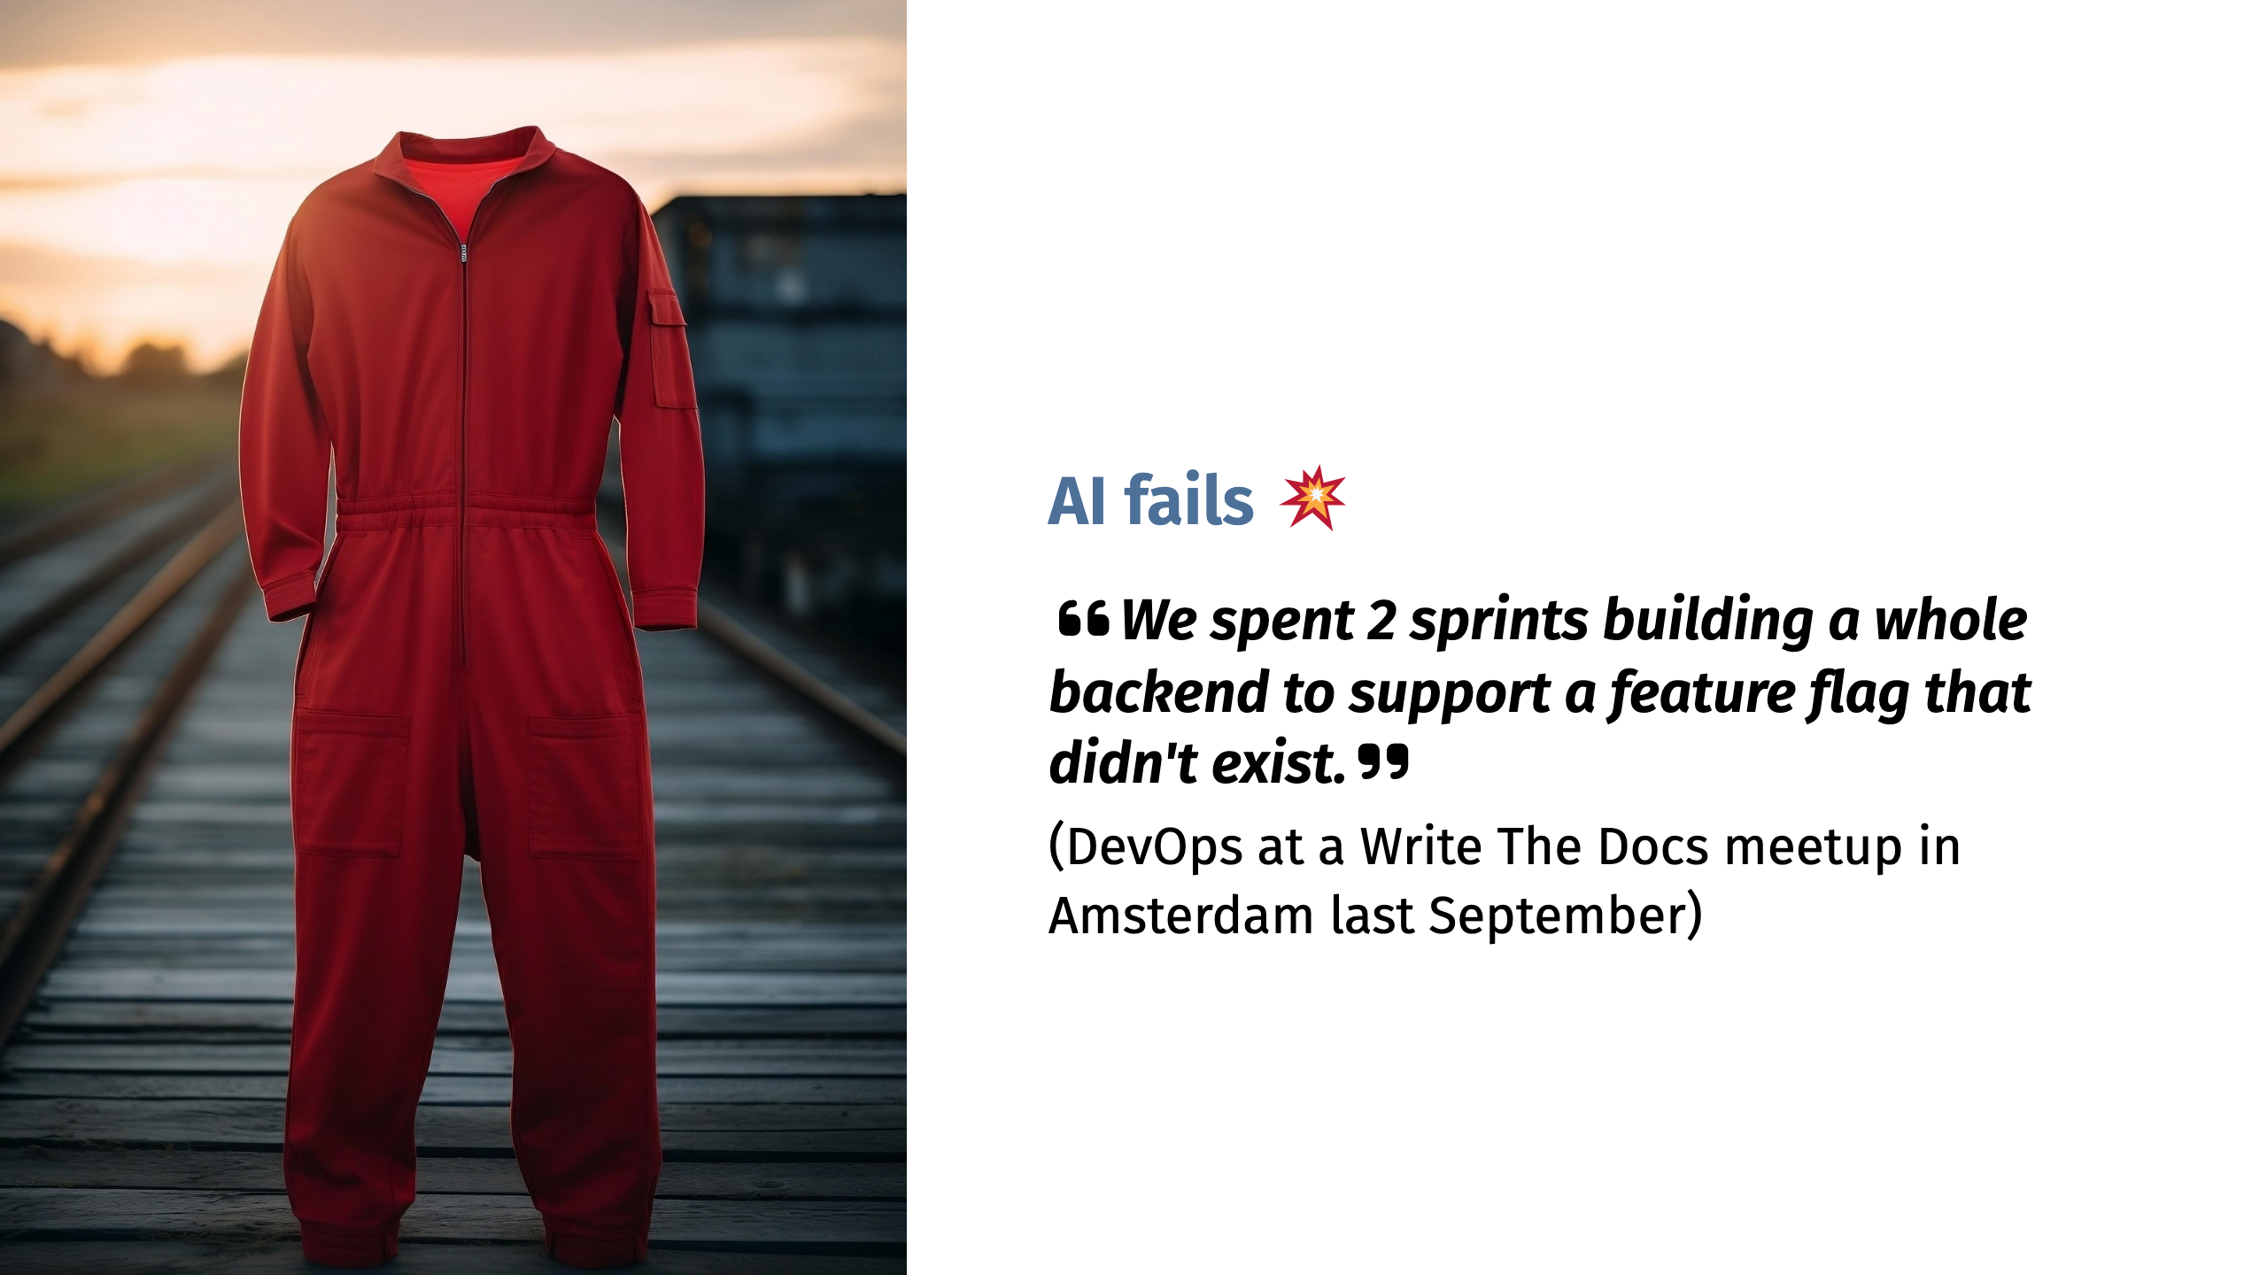

Slide 17
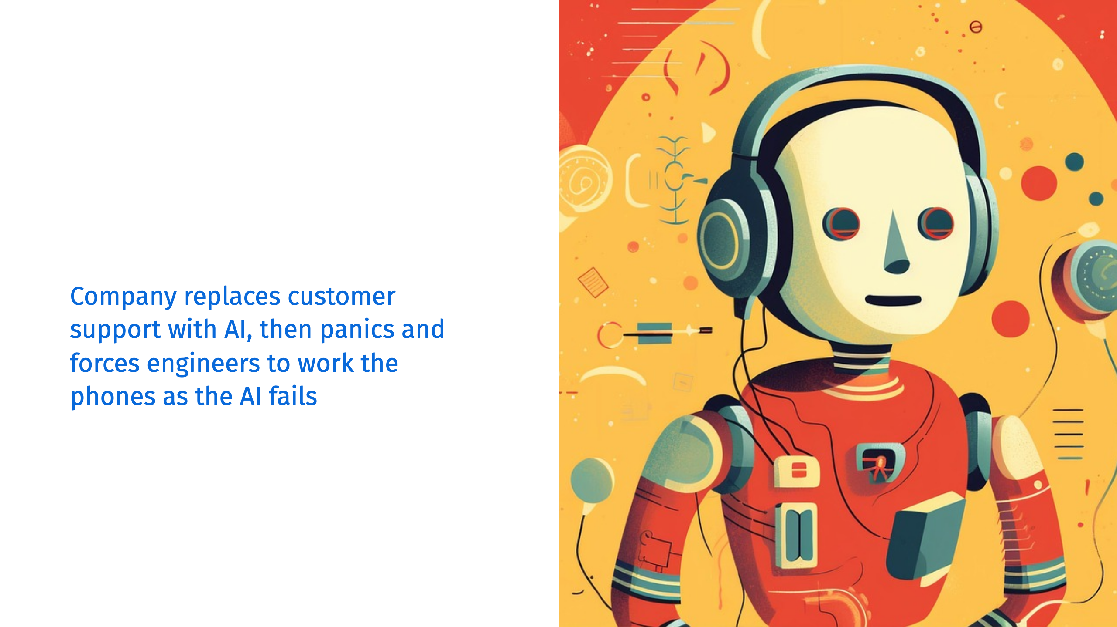

Slide 18


Slide 19


Slide 20
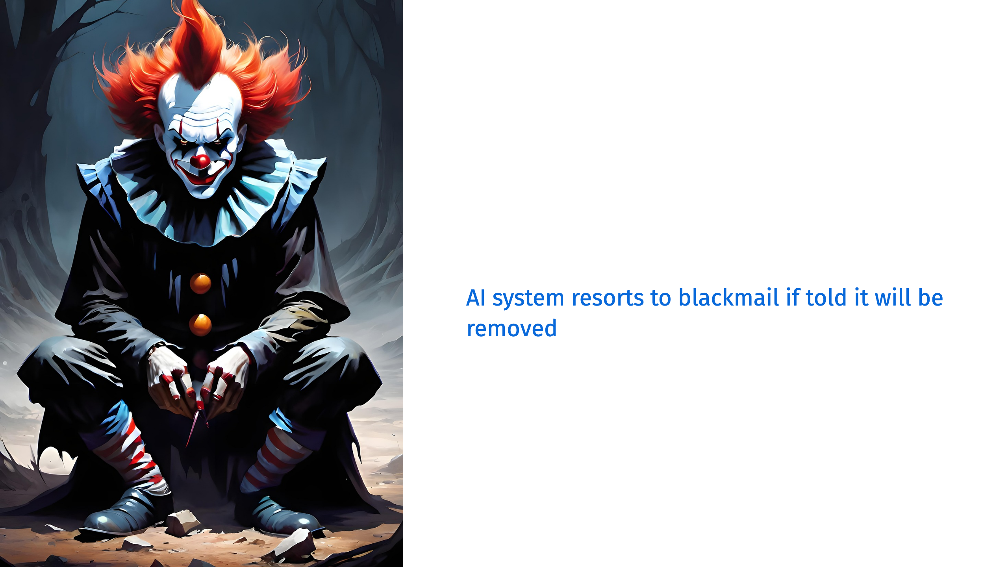

Slide 21


Slide 22


Slide 23

Notes:
Newfoundland, CA. Report to shape their education roadmap for the next 10 years. Even with AI and fake sources, it took 18 months

Slide 24


